Slide 1

Room-mates Spending Tracking and Payment Settlement
Gujjarlapudi Joshi Prakash (20BCS091)
Halbar Sai Kumar (20BCS092)
Harsh Kumar Singh (20BCS095)

Slide 2


What do we do ?
We tackle the problems related to group paying’s like how you should divide your money , how much money will each member will be pay and we help you in such a way that all of your group can pay at the same time and equal amounts without much hassle. Weather you are planning a group trip or paying rent we make it easy.

Slide 3


Our main features…
Pay anyone any amount anytime.
Settle up group related paying’s.
View the requests sent to you by your friends and pay them instantly.

Slide 4


Overall Description
USER FUNCTIONS
Settle up – Helps you pay to anyone any time.
Group pay – Helps you pay in groups.
Request table – Helps you see the paying requests sent to you.
Other functions – Can modify you account details, can send a complain or ask for help, and can decline requests sent to you.

Slide 5
Overall Description
ADMINSTRATIVE
He can view your message or request sent to him.
He can view data of some tables from the data base and if necessary he can modify them.

Slide 6

Operating Environment and External Interface Requirements
Operating system – Windows
Database – SQL Database
Platform – PHP
Front-end – HTML/CSS
Back-end – SQL
Hardware interface – A browser which supports HTML and CSS
Communication interface – The application supports all browsers and forms are used for getting information from the users.

Slide 7
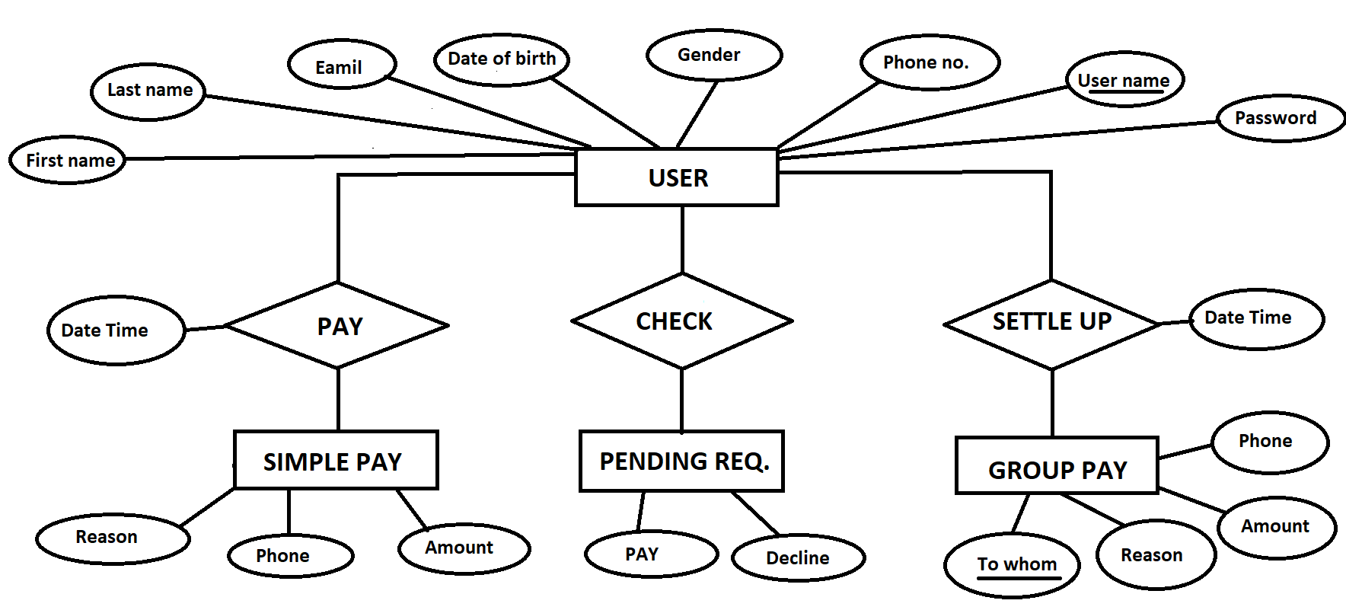
E-R Diagram
Most Attributes are not mentioned to make it simple and understandable…

Slide 8


